Slide 1


CS 6350 Term Project
Team ID : 5
Image to Image transformation using GANs[Pix2Pix]
Guided by : Prof .Dr. Sukendu Das
Shree Harsha K N
(AM23S008)
Vamsi Krishna Badri
(CS23Z078)

Slide 2
PROBLEM STATEMENT
1
1. Issue: Models trained on high-quality DSLR images may underperform on low-quality USB-cam images.
- The difference in image quality between DSLR and USB-cam can affect model performance.
2. Solution: Image-to-image translation model for domain adaptation.
- Train a VAE or GAN-based model to transform the quality of input images.
- This model can adapt low-quality USB-cam images to high-quality DSLR images.
3. Goal: Train an image-to-image translation model for low-quality to high-quality image transformation.
- The model should translate USB-cam low-quality images to high-quality DSLR images.
- The transformed images should have the same dimensions (height and width) as the original DSLR images.
4. Benefits of image-to-image translation:
- Improve model performance on low-quality image inputs.
- Enable better analysis and understanding of USB-cam captured images.

Slide 3
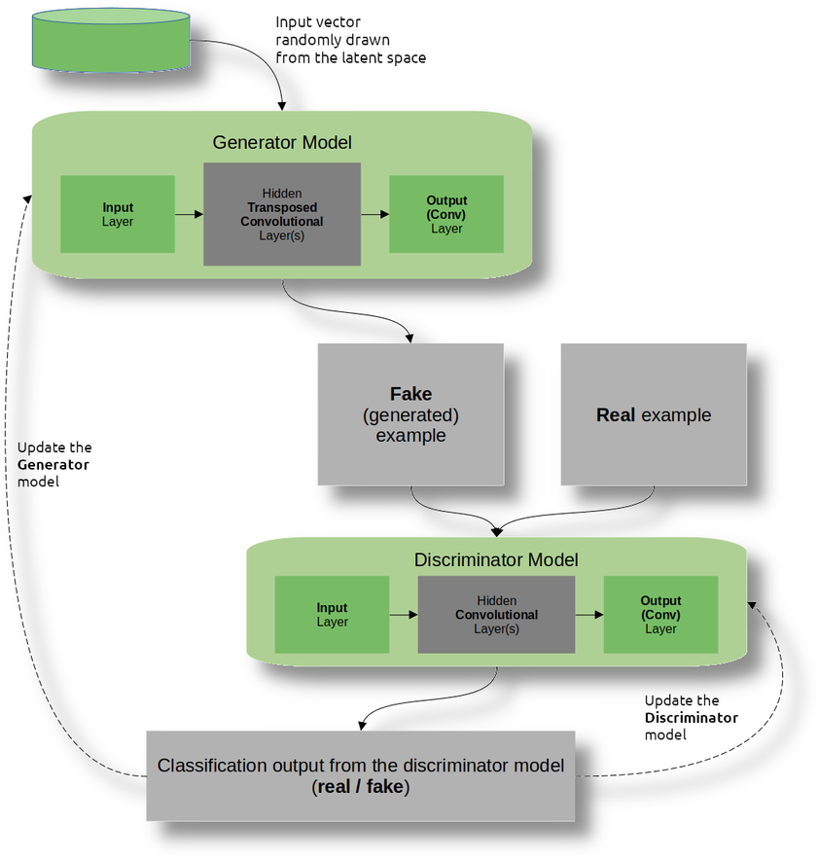
INTRODUCTION
2
GANs are a type of deep learning model that can generate new data based on patterns learned from a training dataset.
GANs consist of two competing networks - a generator network and a
discriminator network - that play a game to generate realistic data.
The generator network creates new data samples, while the discriminator network tries to distinguish between real and generated samples.

Slide 4
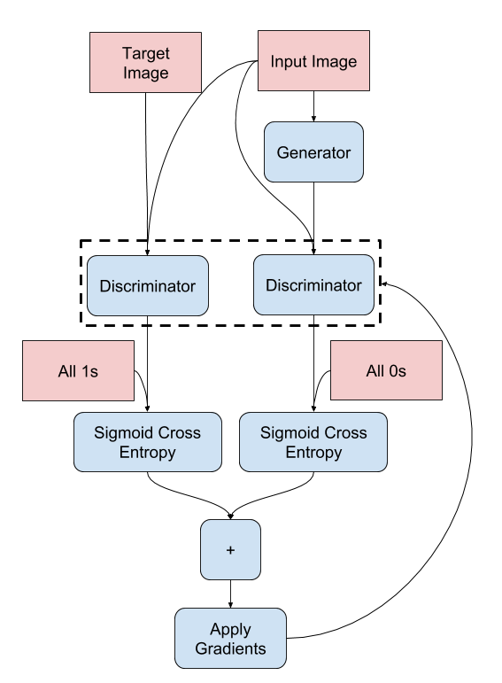
Pix2Pix GANs
3
Pix2Pix is a type of conditional GAN that can learn to map an input image to an output image.
Unlike traditional GANs, which generate new data from noise, Pix2Pix GANs use a paired dataset of input and output images to learn the mapping function.
The architecture of Pix2Pix GANs consists of an encoder-decoder network with skip connections, which allows for both global and local information to be captured and preserved in the output image.
Pix2Pix GANs have many potential applications, such as image-to-image translation, style transfer, and data augmentation for machine learning models.

Slide 5
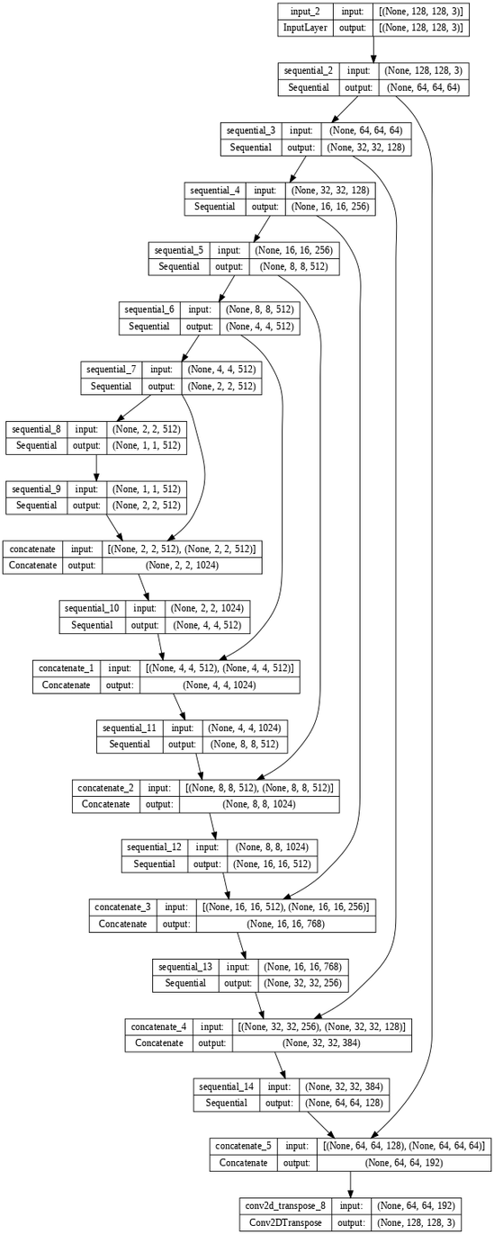
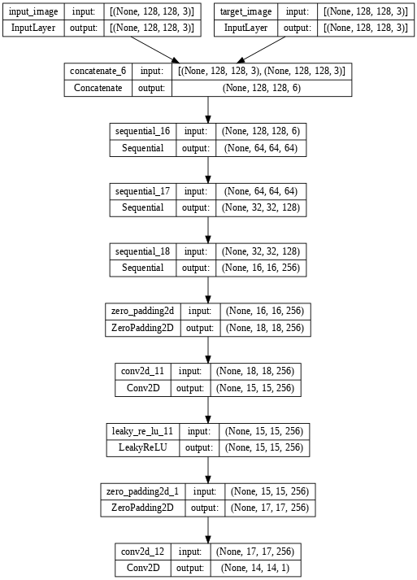
4
Discriminator
Generator

Slide 6
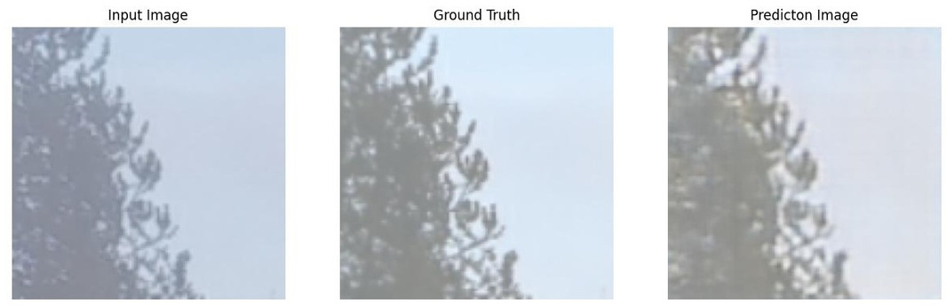
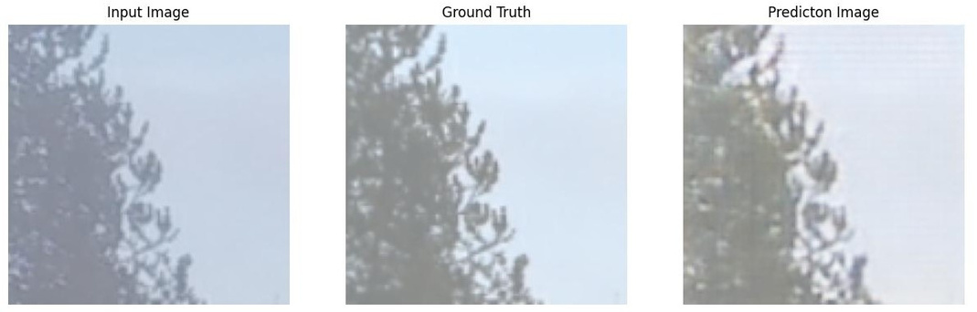
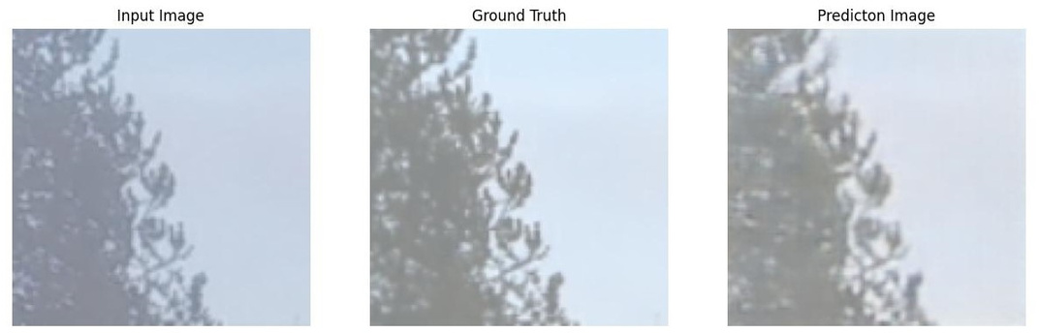
OUTPUT
5
Blackberry Image samples:
Set 1
epoch = 30
epoch = 79
1000 Images
Batch Size 10
Epochs 100
epoch = 86

Slide 7
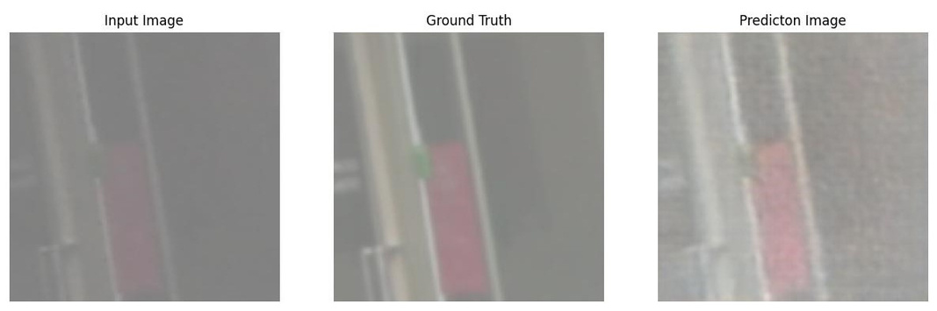
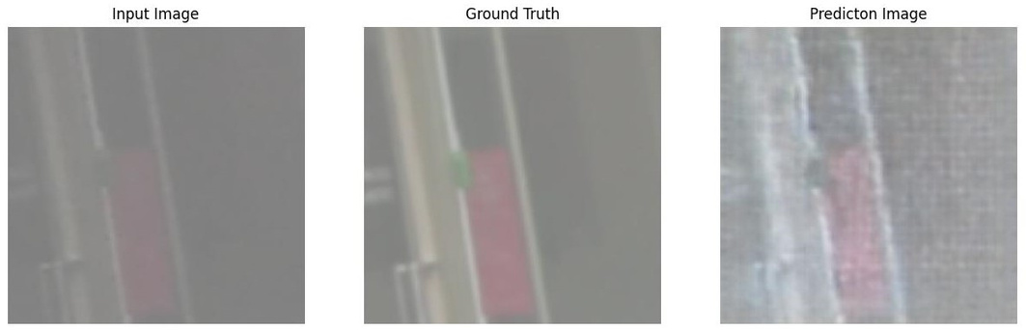
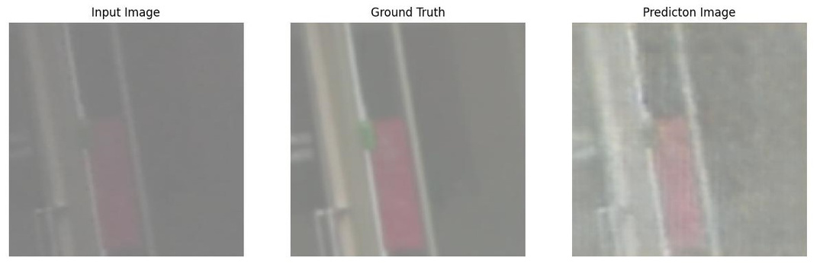
OUTPUT
6
Blackberry Image samples:
Set 2
epoch = 14
epoch = 45
1000 Images
Batch Size 10
Epochs 100
epoch = 90

Slide 8
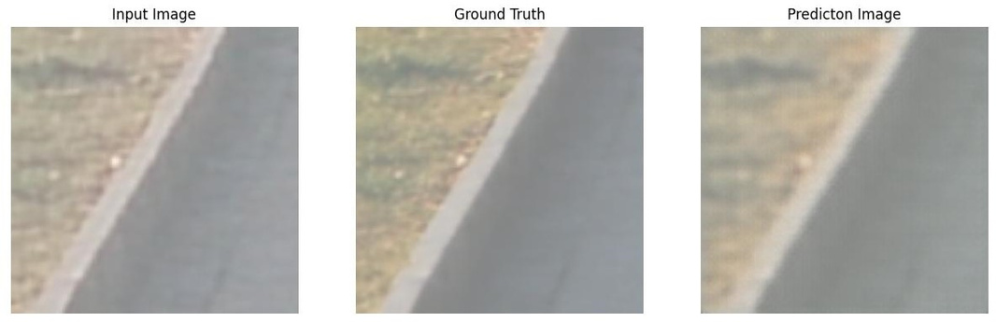
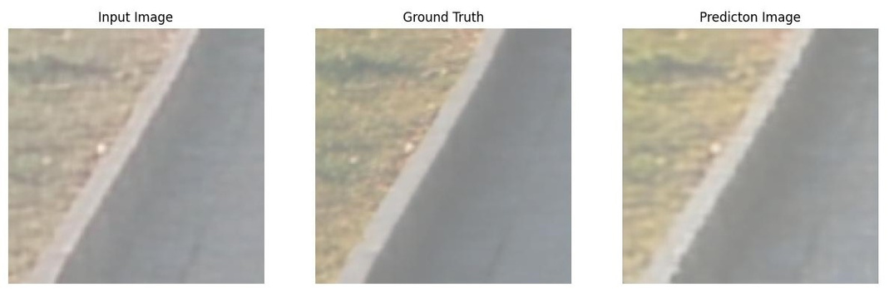
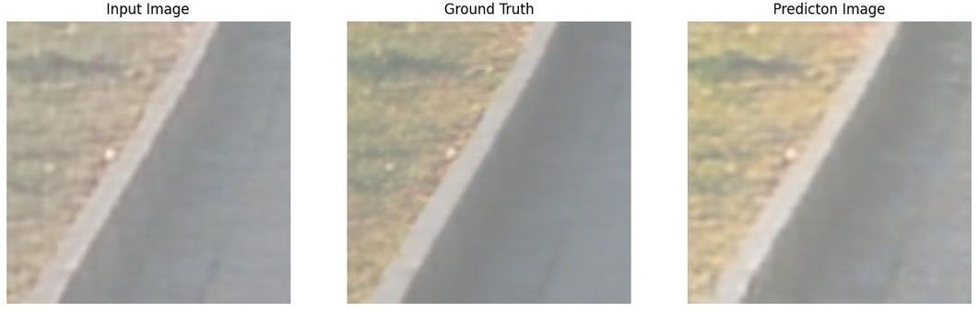
OUTPUT
7
Sony Image samples:
Set 1
epoch = 3
epoch = 64
1000 Images
Batch Size 10
Epochs 100
epoch = 99

Slide 9
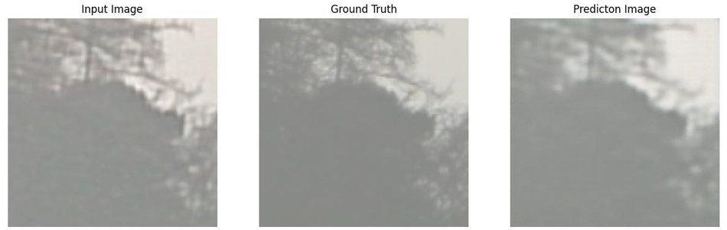
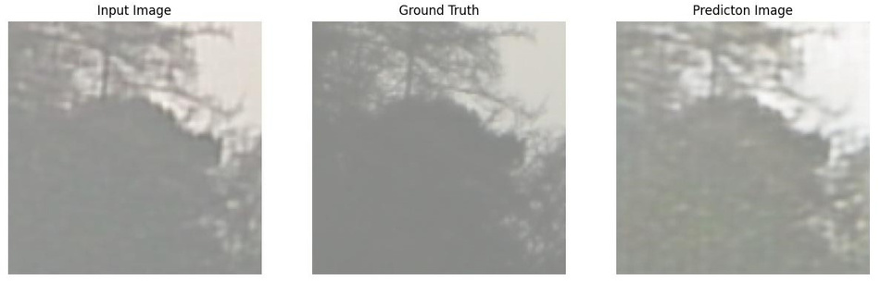
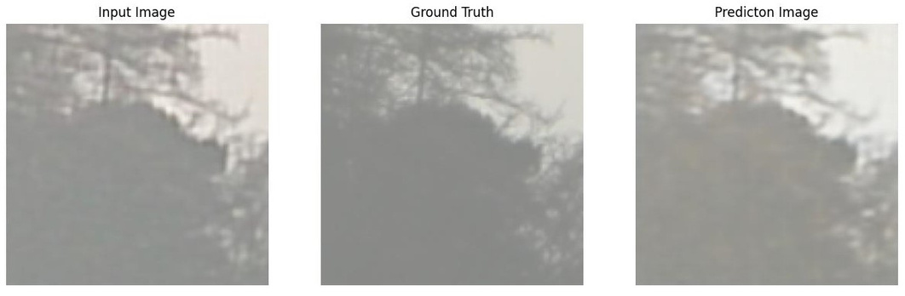
OUTPUT
8
Sony Image samples:
Set 2
epoch = 12
epoch = 63
1000 Images
Batch Size 10
Epochs 100
epoch = 92

Slide 10
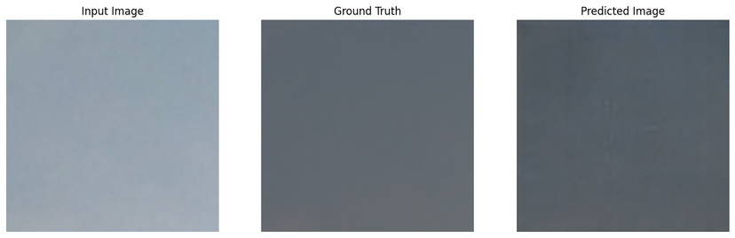
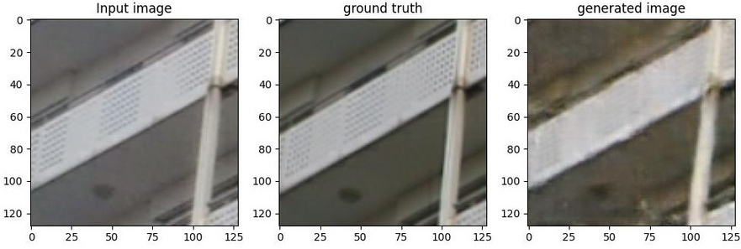
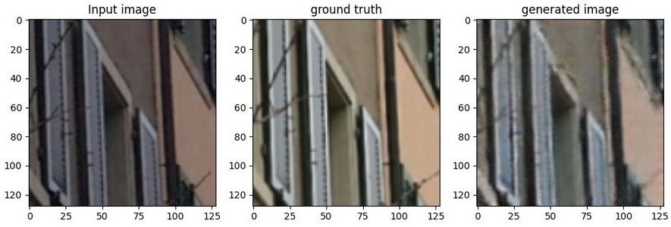
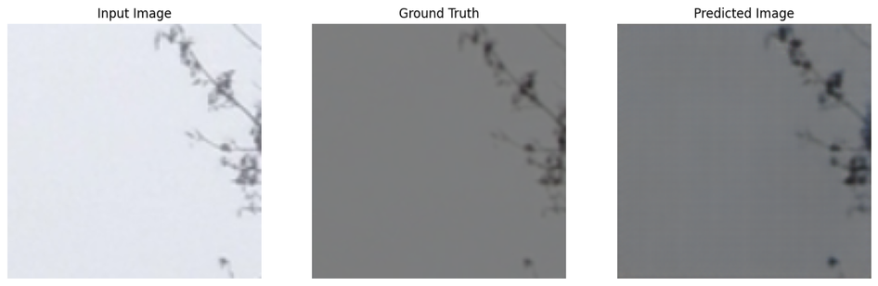
QUANTITATIVE EVALUATION
9
We use classical distance metrics, namely PSNR and SSIM scores: the former measures signal distortion w.r.t. the reference, the latter measures structural similarity which is known to be a strong cue for perceived quality.
SSIM:0.85411215, PSNR:19.880325
SSIM:0.9487559, PSNR:17.235355
SSIM:0.9395153, PSNR:17.168617
SSIM:0.85199744, PSNR:19.780933

Slide 11
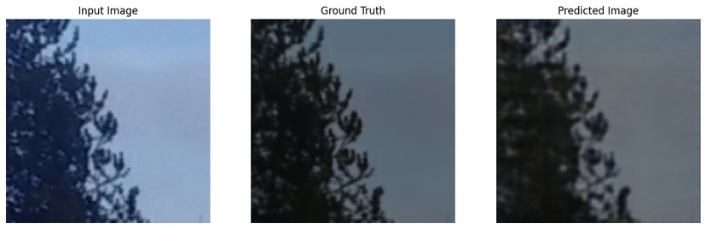
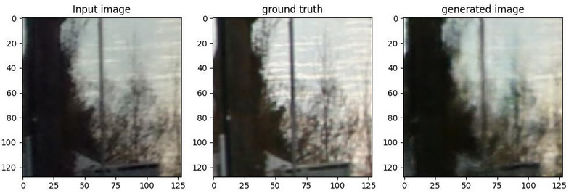
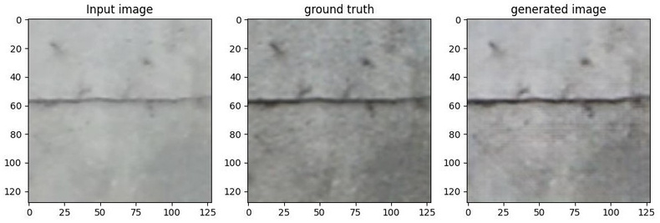
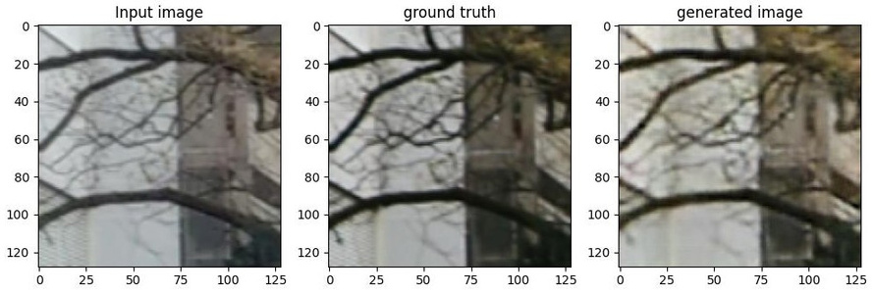
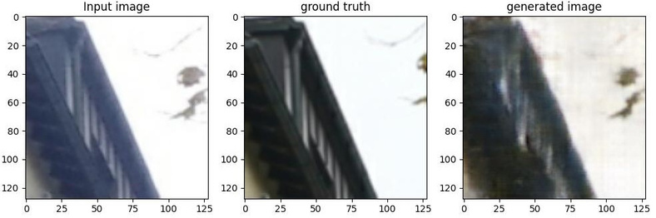
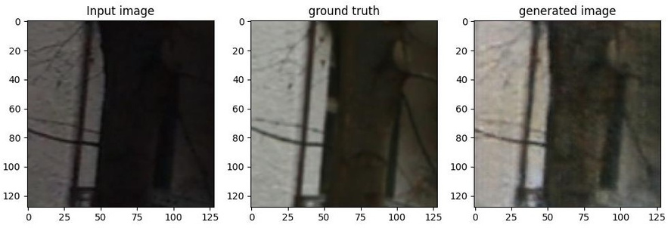
QUANTITATIVE EVALUATION
10
SSIM:0.8059537, PSNR:17.709656
SSIM: 0.90895295, PSNR: 24.369741
SSIM:0.84850055, PSNR:23.684502
SSIM:0.8330156, PSNR:25.415565
SSIM:0.8586055, PSNR:21.674502
SSIM:0.95646165, PSNR:22.68452

Slide 12
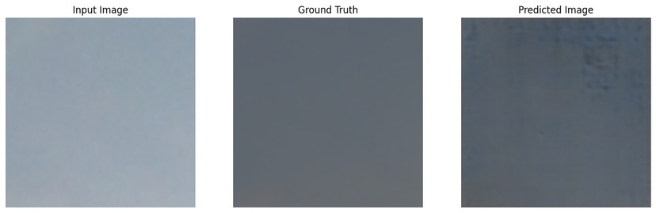
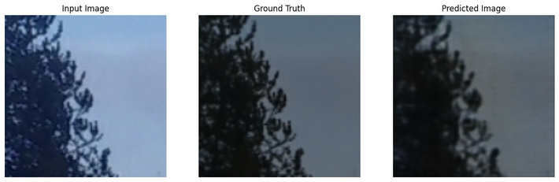
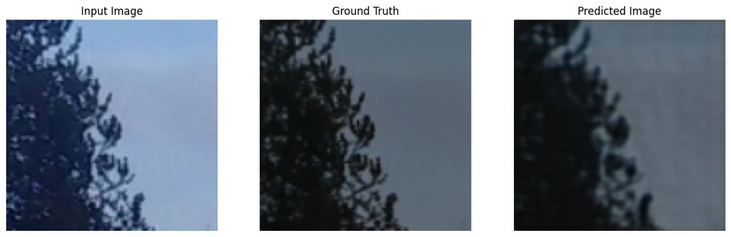
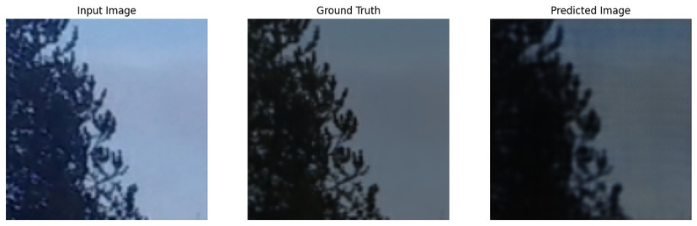
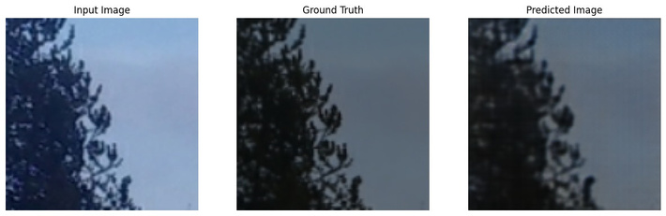
Extra outputs
11

Slide 13
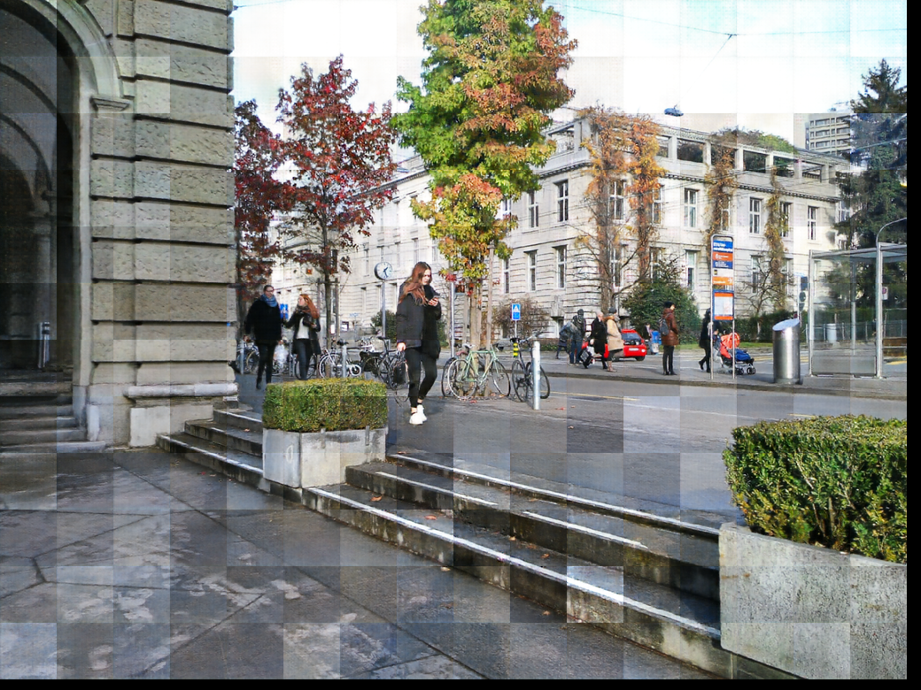
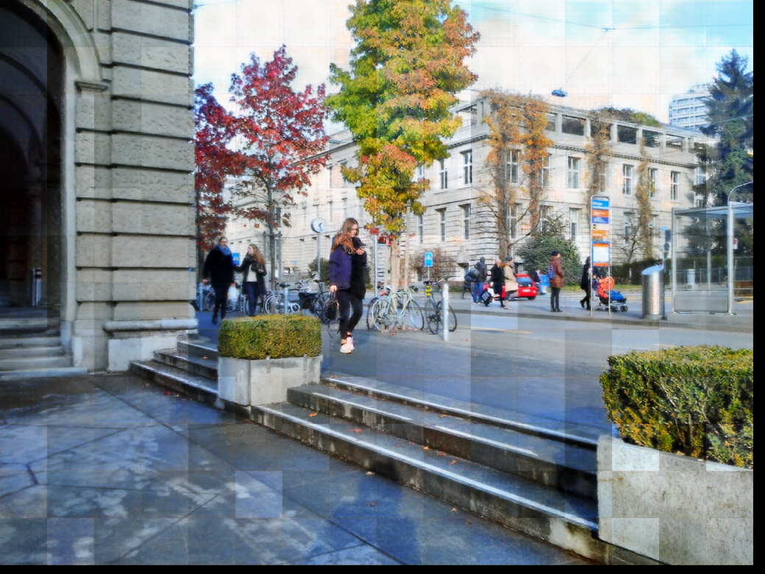
INFERENCE
Blackberry
sony

Slide 14
12
CONCLUSION
The implemented pix2pix algorithm is effective in addressing the domain gap between DSLR and USB-cam images.
The model successfully translates low-quality images to high-quality counterparts with minimal added blur.
The model was trained on 100 x 100 image patches.
Future work: Refining the model to reduce introduced blur and accommodate larger image sizes.
Exploring strategies to accommodate larger image sizes.
Evaluating the model on diverse datasets and real-world scenarios to test its generalization capabilities.

Slide 15
THANK YOU

